Slide 1
Logistics Optimization for Delivery Routes
Project Objective: Build a SQL-driven Logistics analytics system to analyze delays, optimize routes, and enhance shipment efficiency by leveraging queries, aggregations. The project aims to answer key business questions, uncover inefficiencies, and recommend actionable improvements based on data analysis.

Slide 2
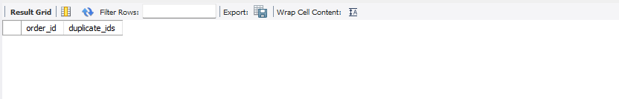
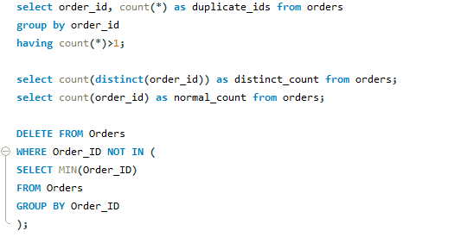


Task 1: Data Cleaning & Preparation
Identify and delete duplicate Order_ID records.
No duplicate records found as distinct count is equal to total count.
If was not equal then use the delete clause.

Slide 3
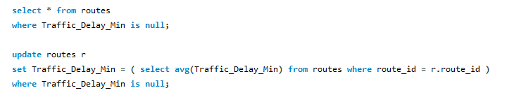
Replace null Traffic_Delay_Min with the average delay for that route.
No Null Traffic Delay Found.

Slide 4
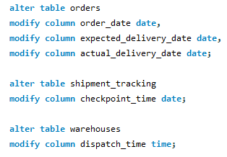
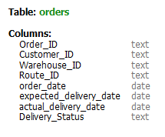


Convert all date columns into YYYY-MM-DD format using SQL functions.
Ensure that no Actual_Delivery_Date is before Order_Date (flag such records).
No such record found where delivery date is before order date.

Slide 5
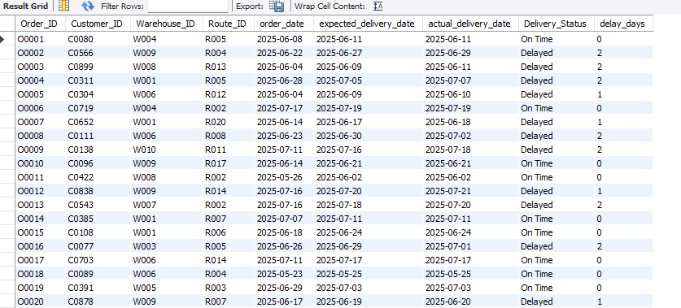
Delivery Delay Analysis
Calculate delivery delay (in days) for each order ●

Slide 6
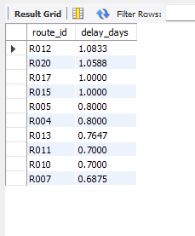

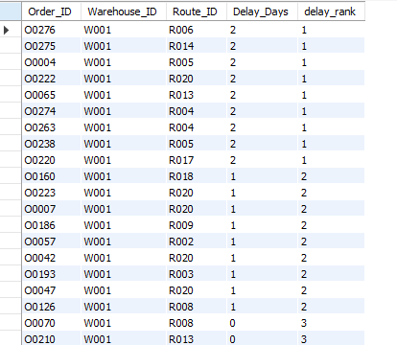
Find Top 10 delayed routes based on average delay days.
Use window functions to rank all orders by delay within each warehouse.

Slide 7
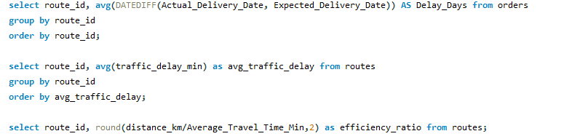
Route Optimization Insights
For each route, calculate:
○ Average delivery time (in days). ○ Average traffic delay. ○ Distance-to-time efficiency ratio

Slide 8
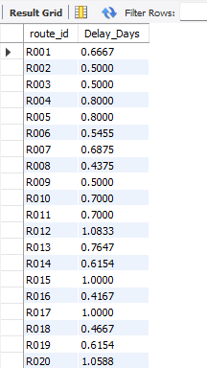
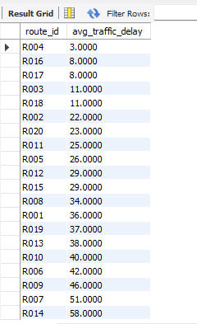
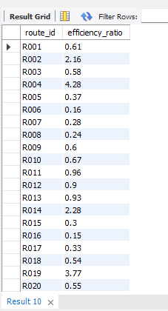

Slide 9
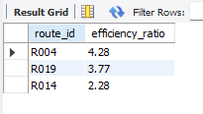

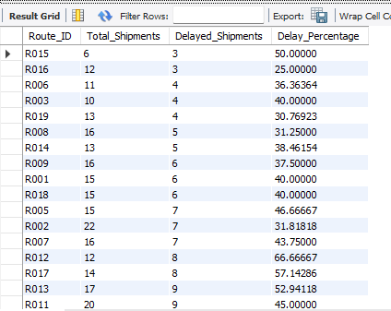
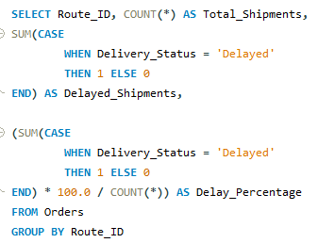
Identify 3 routes with the worst efficiency ratio.
Find routes with >20% delayed shipments.

Slide 10
Recommend potential routes for optimization.
Route ID | Total Shipments | Delay % | Priority Level
R020 | 17 | 70.59% | Critical
R012 | 12 | 66.67% | Critical
R017 | 14 | 57.14% | High

Slide 11


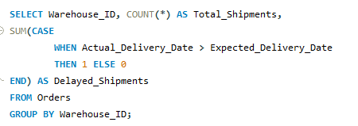
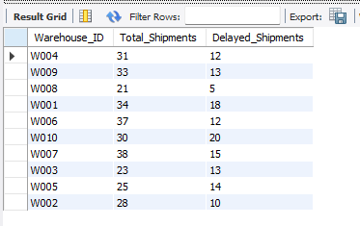
Warehouse Performance
Find the top 3 warehouses with the highest average processing time.
● Calculate total vs. delayed shipments for each warehouse.

Slide 12
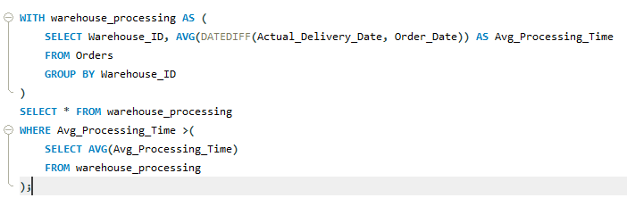
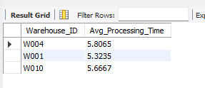
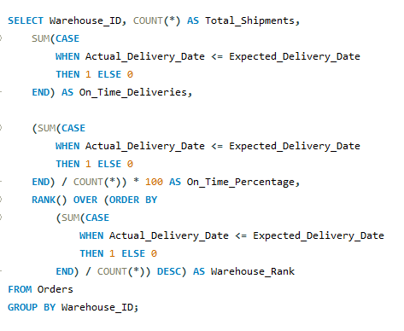
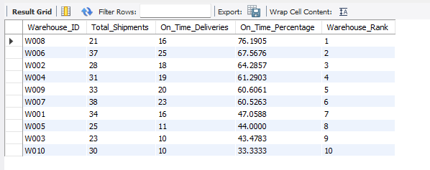
Use CTEs to find bottleneck warehouses where processing time > global average.
Rank warehouses based on on-time delivery percentage.

Slide 13
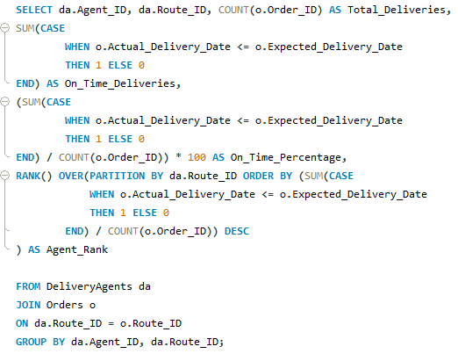
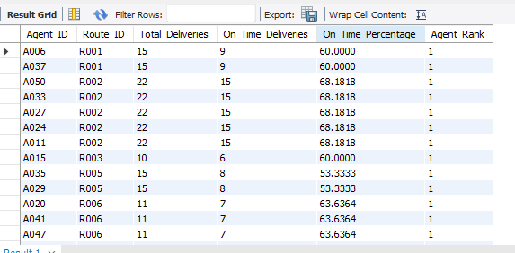
Delivery Agent Performance
Rank agents (per route) by on-time delivery percentage

Slide 14
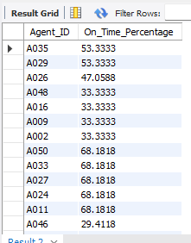
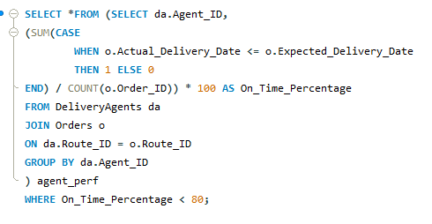
Find agents with on-time % < 80%.

Slide 15
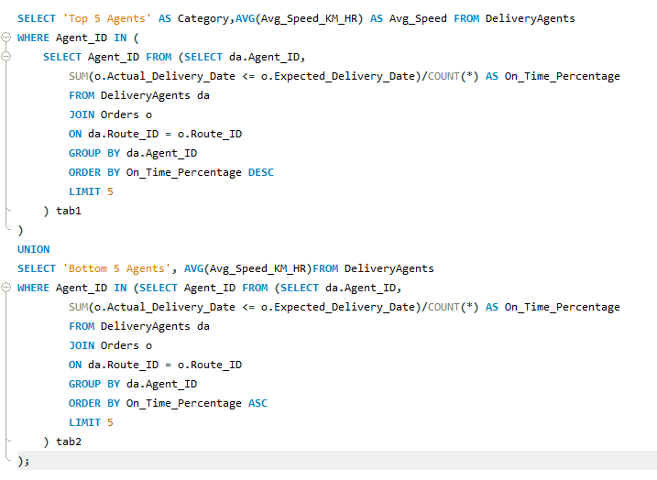
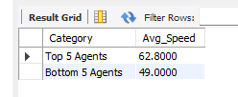
Compare average speed of top 5 vs bottom 5 agents using subqueries

Slide 16
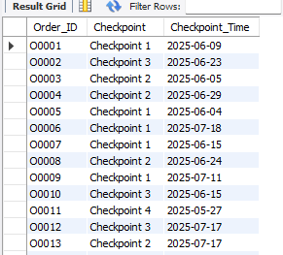
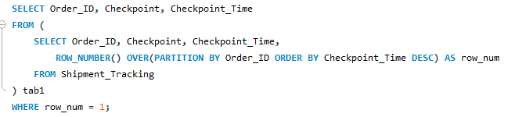
Shipment Tracking Analytics
For each order, list the last checkpoint and time.

Slide 17
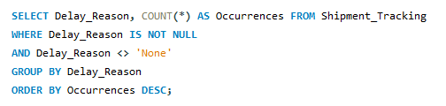
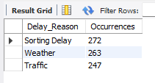
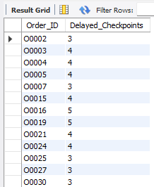
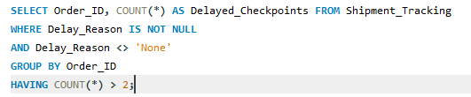
Find the most common delay reasons (excluding None).
Identify orders with >2 delayed checkpoints

Slide 18
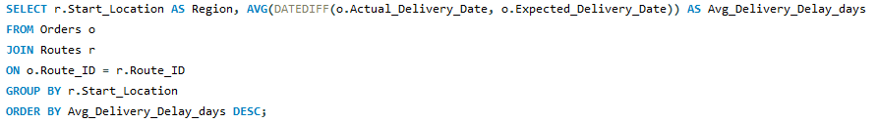
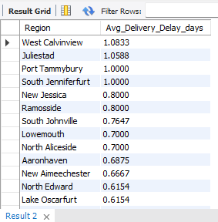
Advanced KPI Reporting
Calculate KPIs using SQL queries:
Average Delivery Delay per Region (Start_Location).

Slide 19
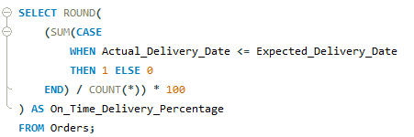

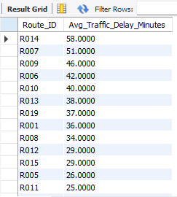

On-Time Delivery % = (Total On-Time Deliveries / Total Deliveries) * 100.
Average Traffic Delay per Route.

Slide 20
EXPLANATION VIDEO
Explanation_Video_Link

